Slide 1
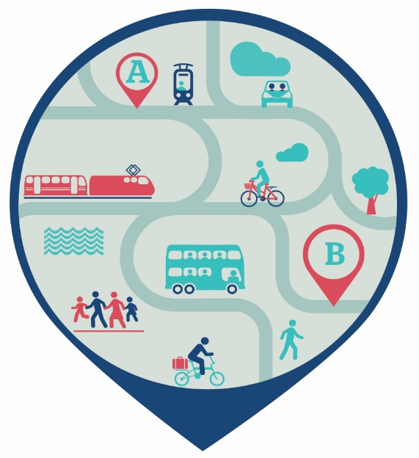
Transport Strategy / Mobility Management Plan
A sustainable transport strategy to reduce car usage, increase walking, cycling and public transport and facilitate current & future developments
Why is it important ?
The site is a significant “trip generator”
Developments on the site
Surrounding areas not adversely effected
Need to address car dependency & traffic
Tight inner city location
Parking constraints
Grant of planning

Slide 2
Implementation
Green lead appointed in CHI – Responsible for the Mobility Plan
Roll out of Smartertravel initiatives in CHI & SJH
New and improved secure bike parking across the campus
Significant increase in staff cycling to work
MISA Gate - Better access for pedestrians and cyclists
Active Travel Grants - Improved cycling & pedestrian infrastructure
Bus Connects
Three new bus routes – O, S2 & 73
30 buses an hour at peak times
3 Core Bus Corridor
Electric buses

Slide 3
Implementation
Future plans / actions
New ebikes scheme for staff – booking via App
Parking Management
Demand Responsive Transport Pilot (DRT)
Collaborative approach - Transport, Academic, Tech
A bus / taxi hybrid that can meet the diverse needs of patients, staff and visitors
Combines the affordability of public transport with the convenience of the car
Pre-book journeys etc via App
Virtual stops, zonal & flexible routes

Slide 4
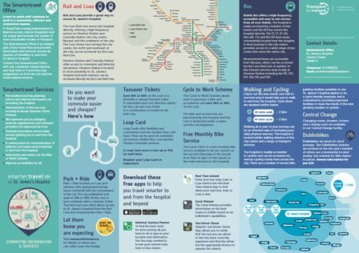
Implementation
Future plans / actions
Agreed communications strategy
Additional bus stops
Closing the campus to through traffic
Works to improve traffic flows
Proactive promotion of the Taxsaver
ticket and Bike to Work schemes.
Leverage support from the NTA & DCC for continued improvements
Integrate the SJH & CHI Smartertravel programmes

Slide 5
Covid
Significant impact on the implementation of the Mobility Plan
Working Group to reconvene
Public transport / Taxsaver ticket scheme declined significantly
Increase in car usage
Survey to monitor progress in May 2020 – cancelled
Focus
Opportunity to refocus efforts
Renewed emphasise on the Smartertravel programme
Parking strategy – “critical to the success” of the strategy / MMP
Address congestion on James Street
Targets and objectives in plan
An accessible campus

